Slide 1

Machine Learning & Data Mining CS/CNS/EE 155
Lecture 1:
Administrivia & Review

Slide 2
Course Info
Lecture (Tu/Th)
2:30pm – 3:55pm in 105 Annenberg
Recitation (W)
5:00pm – 7:00pm in 105 Annenberg
As needed
Usually less than the full 2 hours

Slide 3
Staff
Instructor: Yisong Yue
Office in 303 Annenberg
TAs:
Bryan He
Masoud Farivar
Shenghan Yao
Vighnesh Shiv
Minfa Wang
Vinny Augustine

Slide 4
Course Prerequisites
Algorithms and statistics
CS/CNS/EE/NB 154 or CS/CNS/EE 156a
Calculus and algebra
Comfort in mathematical reasoning
Do Homework 0!
If you have a lot of trouble, consider dropping
(especially underclassmen)
Take CS 156a next year first
If you plan to drop, do it early.

Slide 5
Course Breakdown
5-6 Homeworks, 30-40% of final grade
Due Tuesdays
Homework 1 release next Monday
2-3 Mini-projects, 20-30% of final grade
Final, 30-40% of final grade

Slide 6
Course Etiquette
Please ask questions during lecture!
I might defer some in interest of time
If you arrive late, or need to leave early, please do so quietly.
Adhere to the Academic Integrity
50ft policy

Slide 7
Course Website
http://www.yisongyue.com/courses/cs155
Linked to from my website:
http://www.yisongyue.com
Up-to-date office hours
Lecture notes, additional reading, homeworks, etc.

Slide 8
Moodle
https://courses.caltech.edu/course/view.php?id=1787
Linked to from course website
Forums & Assignment Submission
Requires Enrollment Key

Slide 9
Caveats
This is my first time teaching a course…. ever.
Please be understanding.

Slide 10
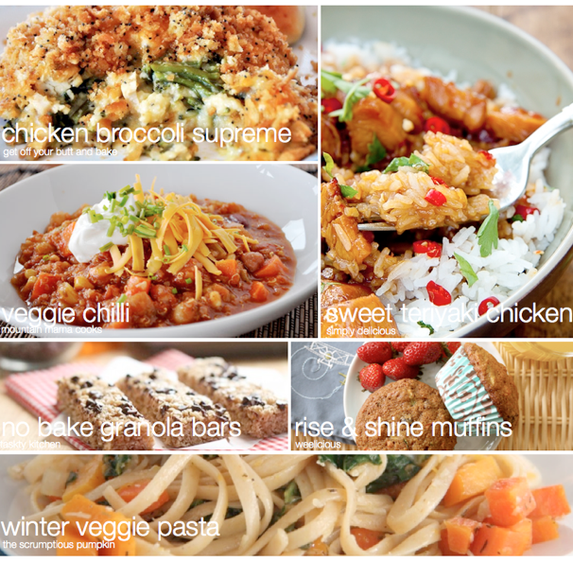

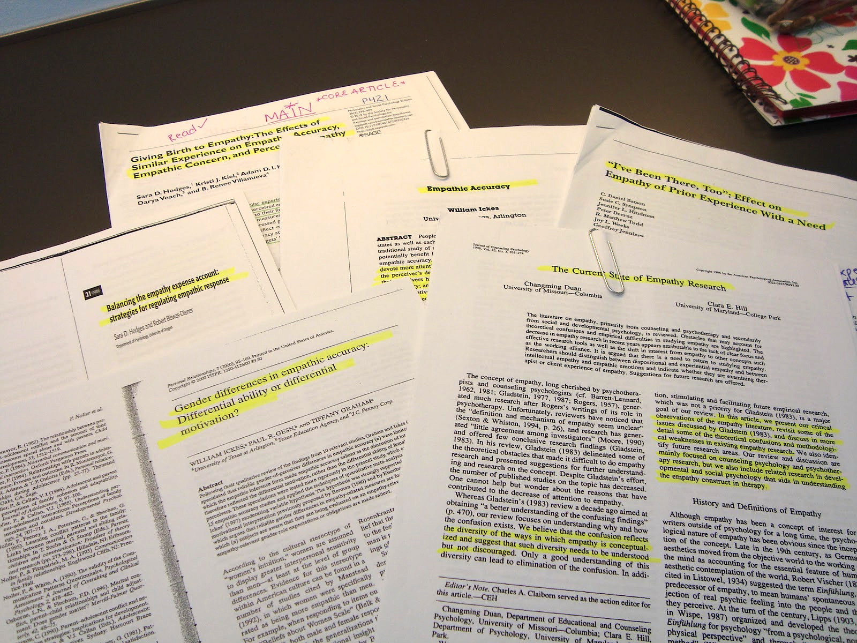

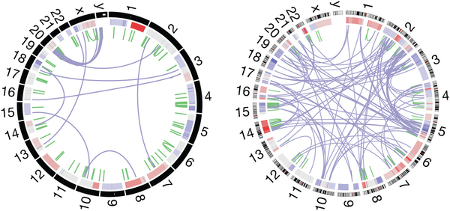

Machine Learning & Data Mining
Computer Algorithm
Process of Converting
Data & Experience
Into Knowledge
Computer Model

Slide 11
Machine Learning vs Data Mining
ML focuses more on algorithms
Typically more rigorous
Also on analysis (learning theory)
DM focuses more on knowledge extraction
Typically uses ML algorithms
Knowledge should be human-understandable
Huge overlap

Slide 12
Course Outline
Review over basics (this week)
Modern techniques:
Lasso
HMMs & Graphical Models
Ensemble Methods (boosting)
Latent factor models, topic models, deep learning
Semi-supervised & active learning.

Slide 13

Example: Spam Filtering
FUNCTION SpamFilter(string document)
{
IF(“Viagra” in document)
RETURN TRUE
ELSE IF(“NIGERIAN PRINCE” in document)
RETURN TRUE
ELSE IF(“Homework” in document)
RETURN FALSE
ELSE
RETURN FALSE
END IF
}
Goal: write a program to filter spam.
Viagra, Cialis, Levitra
Reminder: homework due tomorrow.
Nigerian Prince in Need of Help
SPAM!
NOT SPAM
SPAM!

Slide 14
Why is Spam Filtering Hard?
Easy for humans to recognize
Hard for humans to write down algorithm
Lots of IF statements!

Slide 15
Machine Learning to the Rescue!
Training Set
SPAM!
Build a Generic Representation
Run a Generic Learning Algorithm
➔ Classification Model
SPAM!
NOT SPAM
NOT SPAM
SPAM!
SPAM!
…
Labeled by Humans

Slide 16
Bag of Words Representation
Training Set
Bag of Words
SPAM!
(0,0,0,1,1,1)
“Feature Vector”
One feature for
each word in the
vocabulary
In practice 10k-1M
SPAM!
(1,0,0,1,0,0)
NOT SPAM
(1,0,1,0,1,0)
NOT SPAM
(0,1,1,0,1,0)
SPAM!
(1,0,1,1,0,1)
SPAM!
(1,0,0,0,0,1)
…
…

Slide 17
Linear Models
Let x denote the bag-of-words for an email
E.g., x = (1,1,0,0,1,1)
Linear Classifier:
f(x|w,b) = sign(w^{T}x – b)
= sign(w₁*x₁ + … w₆*x₆ – b)
Goal: learn (w,b) using training data

Slide 18
Learning Goal
f(x|w,b) = sign(w^{T}x – b)
= sign(w₁*x₁ + … w₆*x₆ – b)
w = (1,0,0,1,0,1)
b = 1.5
Training Set
Bag of Words
SPAM!
(0,0,0,1,1,1)
f(x|w,b) = +1
SPAM!
(1,0,0,1,0,0)
f(x|w,b) = +1
NOT SPAM
(1,0,1,0,1,0)
f(x|w,b) = -1
NOT SPAM
(0,1,1,0,1,0)
f(x|w,b) = -1
SPAM!
(1,0,1,1,0,1)
f(x|w,b) = +1
SPAM!
(1,0,0,0,0,1)
f(x|w,b) = +1
…
…
…

Slide 19

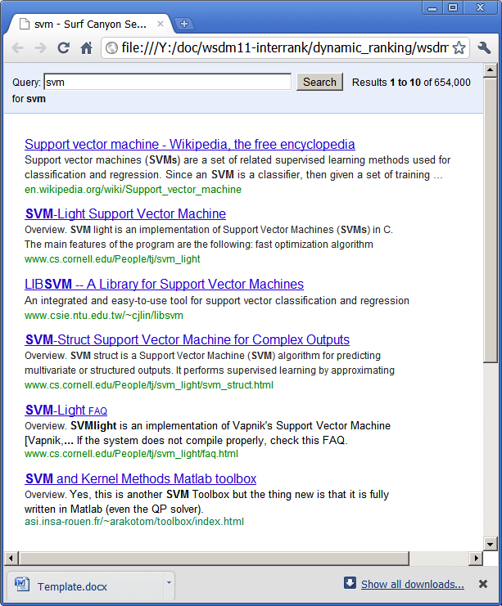
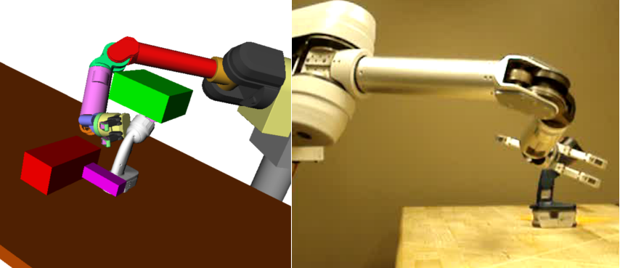


Linear Models
Workhorse of Machine Learning
By end of this lecture, you’ll learn 75% how to build basic linear model.

Slide 20
Two Basic ML Problems
Classification
Predict which class an example belongs to
E.g., spam filtering example
Regression
Predict a real value or a probability
E.g., probability of being spam
Highly inter-related
Train on Regression => Use for Classification

Slide 21
Learning Goal
f(x|w,b) = w^{T}x – b
= w₁*x₁ + … w₆*x₆ – b
w = (1,0,0,1,0,1)
b = 1.5
Training Set
Bag of Words
SPAM!
(0,0,0,1,1,1)
f(x|w,b) = +0.5
SPAM!
(1,0,0,1,0,0)
f(x|w,b) = +0.5
NOT SPAM
(1,0,1,0,1,0)
f(x|w,b) = -0.5
NOT SPAM
(0,1,1,0,1,0)
f(x|w,b) = -1.5
SPAM!
(1,0,1,1,0,1)
f(x|w,b) = +1.5
SPAM!
(1,0,0,0,0,1)
f(x|w,b) = +0.5
…
…
…

Slide 22
Formal Definitions
Training set:
Model class:
aka hypothesis class
Goal: find (w,b) that predicts well on S.
How to quantify “well”?
Linear Models

Slide 23
Basic Recipe
Training Data:
Model Class:
Loss Function:
Learning Objective:
Linear Models
Squared Loss
Optimization Problem

Slide 24
Loss Function
Measures penalty of mis-prediction:
0/1 Loss:
Squared loss:
Substitute: a=y, b=f(x)
Classification
Regression

Slide 25
Scale difference doesn’t matter
Only shape difference of Loss
Perfect Squared Loss implies perfect 0/1 Loss
Squared Loss
Loss
0/1 Loss
Target y
f(x)

Slide 26
Learning Goal
f(x|w,b) = w^{T}x – b
= w₁*x₁ + … w₆*x₆ – b
w = (0.05, 0.05, -0.68, 0.68, -0.63, 0.68)
b = 0.27
Training Set
Bag of Words
SPAM!
(0,0,0,1,1,1)
f(x|w,b) = +1
SPAM!
(1,0,0,1,0,0)
f(x|w,b) = +1
NOT SPAM
(1,0,1,0,1,0)
f(x|w,b) = -1
NOT SPAM
(0,1,1,0,1,0)
f(x|w,b) = -1
SPAM!
(1,0,1,1,0,1)
f(x|w,b) = +1
SPAM!
(1,0,0,0,0,1)
f(x|w,b) = +1
Train using Squared Loss

Slide 27
Learning Algorithm
Typically, requires optimization algorithm.
Simplest: Gradient Descent
Loop for T
iterations

Slide 28
Gradient Review
See Recitation
on Wednesday!
Linearity of Differentiation
Chain Rule

Slide 29
Squared Loss
How to compute
gradient for 0/1 Loss?
Loss
0/1 Loss
Target y
f(x)

Slide 30
0/1 Loss is Intractable
0/1 Loss is flat or discontinuous everywhere
VERY difficult to optimize using gradient descent
Solution: Optimize smooth surrogate Loss
E.g., Squared Loss

Slide 31
Recap: Two Basic ML Problems
Classification
Predict which class an example belongs to
E.g., spam filtering example
Regression
Predict a real value or a probability
E.g., probability of being spam
Highly inter-related
Train on Regression => Use for Classification

Slide 32
Recap: Basic Recipe
Training Data:
Model Class:
Loss Function:
Learning Objective:
Congratulations!
You now know the basic steps to training a model!
Linear Models
But is your model any good?
Squared Loss
Optimization Problem

Slide 33
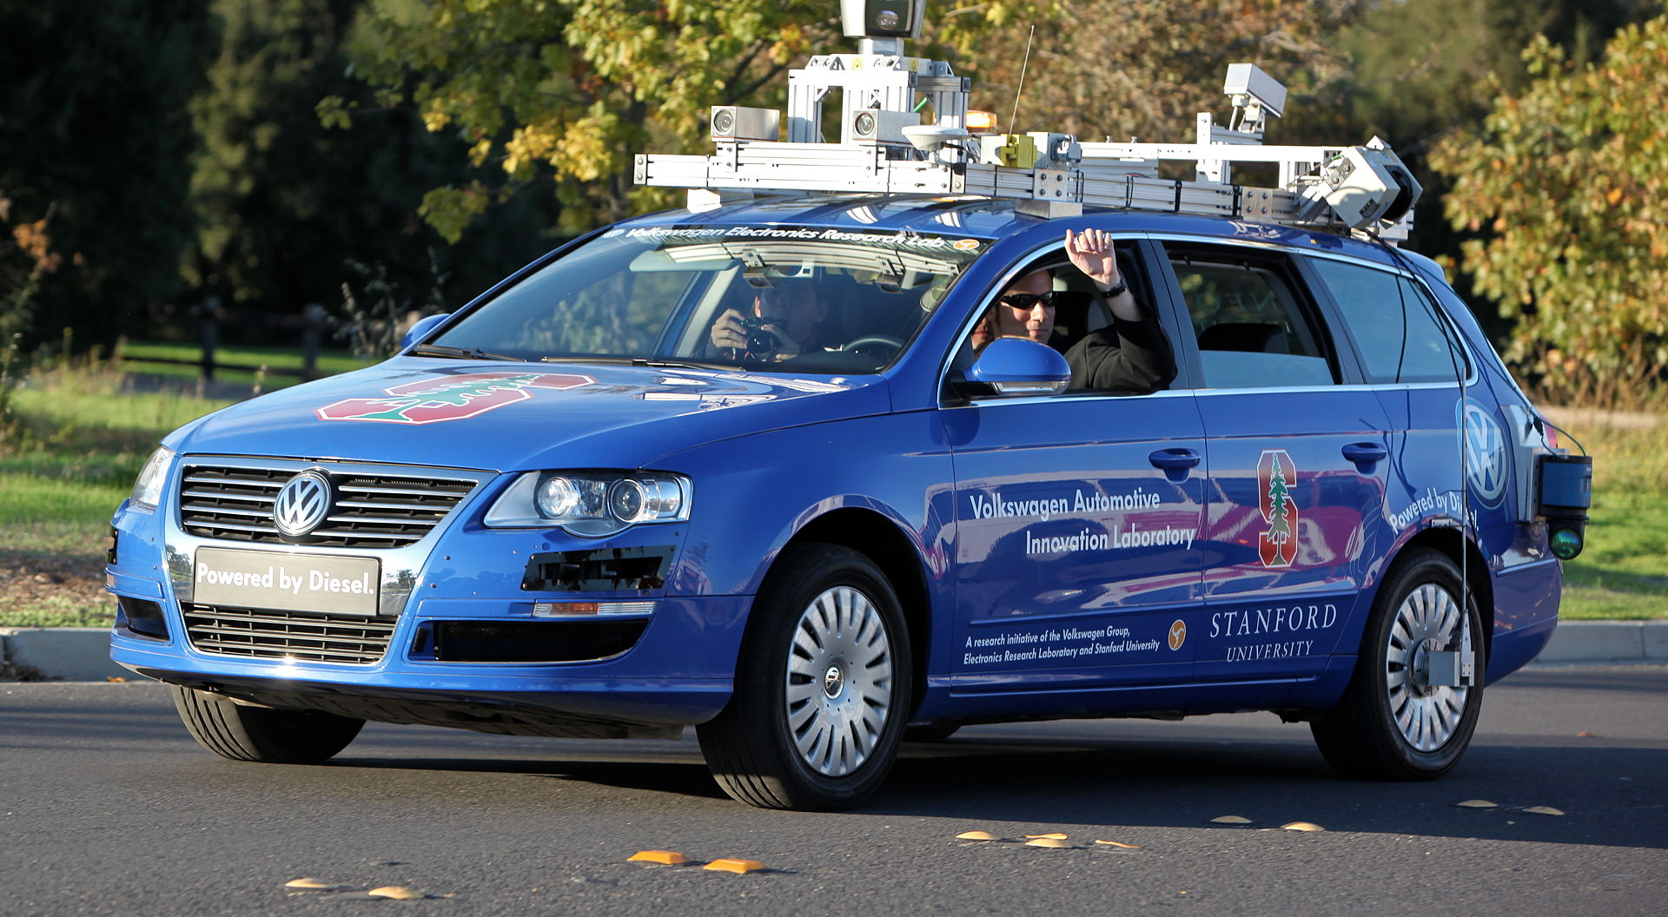
Example: Self-Driving Cars

Slide 34
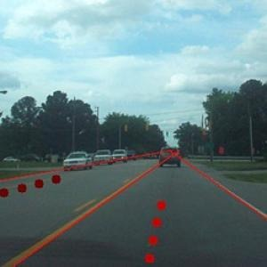

Basic Setup
Mounted cameras
Use image features
Human demonstrations
f(x|w) = steering angle
Learn on training set

Slide 35
Result?
Overfitting
Very accurate model
But crashed on live test!
Model w only cared about staying between two green patches

Slide 36
Test Error
“True” distribution: P(x,y)
Unknown to us
Train: f(x) = y
Using training data:
Sampled from P(x,y)
Test Error:
Overfitting: Test Error > Training Error
“All possible emails”
Prediction Loss on
all possible emails

Slide 37
Test Error
Test Error:
Treat f_{S} as random variable:
Expected Test Error:

Slide 38
Bias-Variance Decomposition
For squared error:
Variance Term
Bias Term
“Average prediction”

Slide 39
Example P(x,y)
y
x

Slide 40
f_{S}(x) Linear

Slide 41
f_{S}(x) Quadratic

Slide 42
f_{S}(x) Cubic

Slide 43
Bias-Variance Trade-off
Bias
Variance
Bias
Variance
Bias
Variance

Slide 44
Overfitting vs Underfitting
High variance implies overfitting
Model class unstable
Variance increases with model complexity
Variance reduces with more training data.
High bias implies underfitting
Even with no variance, model class has high error
Bias decreases with model complexity
Independent of training data size

Slide 45
Model Selection
Finite training data
Complex model classes overfit
Simple model classes underfit
Goal: choose model class with the best generalization error
But we can’t measure generalization error directly!
(We don’t have access to the whole distribution.)

Slide 46
5-Fold Cross Validation
Split training data into 5 equal partitions
Train on 4 partitions
Evaluate on 1 partition
Allows re-using training data as test data
Training Data

Slide 47

Complete Pipeline
Training Data
Model Class(es)
Loss Function
Cross Validation & Model Selection
Profit!

Slide 48
Next Lecture
Beyond basic linear models
Logistic Regression, Perceptrons & SVMs
Feed-Forward Neural Nets
Different loss functions
Different evaluation metrics
Recitation on Wednesday:
Linear Algebra, Vector Calculus & Optimization

